Slide 1
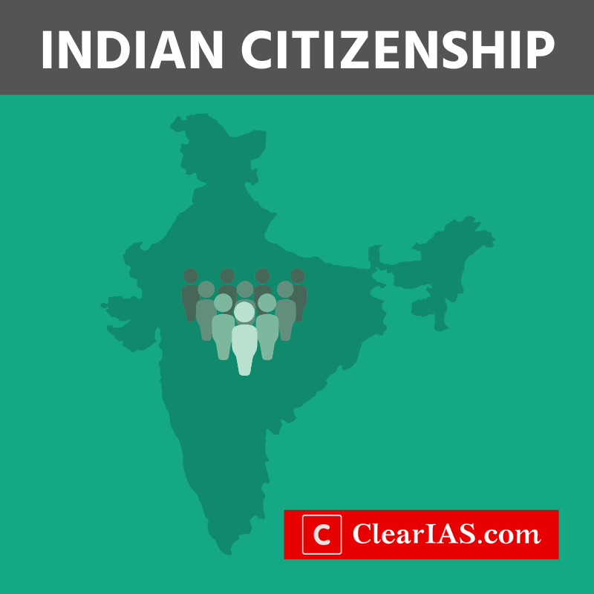
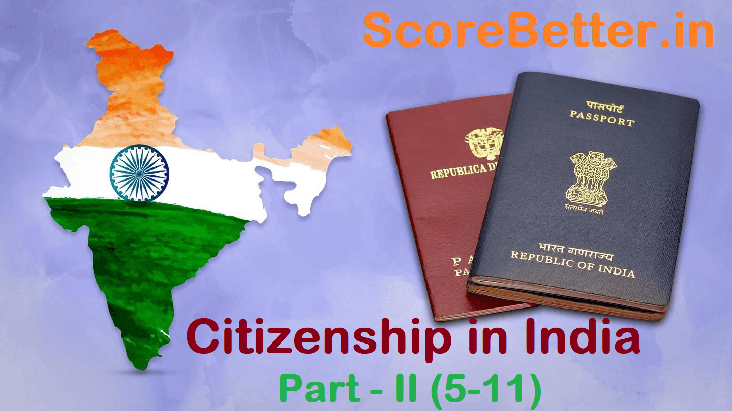
Puttu Guru Prasad

Slide 2
Professor & Lawyer
Puttu Guru Prasad
B.Com., M.Com., M.Phil., M.B.A., PGDFTM., AP.SET., M.Phil., DRMS., L.L.B.,
ICFAI TMF., DIRM., L.L.M., Pre PhD (PhD)from JNTUK., Topper
Domain Topper & 30th Batch Topper at ICFAI -2009 (TMF) LL.B Degree Gold Medallist from ANU-2005
LL.M Degree First Class with Distinction from ANU-2019
“Diploma in Psychology from YALE University”
MHRDI’s 'Institution's Innovation Council (IICs)Ambassador
NSS Certified Program Officer, (A.U)
ICFAI UNIVERSITY Trained Senior MBA Faculty
Eminent Faculty for Law, Accounts, Business Studies, Economics,
Head, Board of Administration & Management Science,
BHAGAVAD GITA & CLAT & IPMAT Program Coordinator,
Commerce Department, VIVA-VVIT, Nambur,
My Blog: puttuguru.blogspot.in My Web Site: https://gurublogs.wixsite.com/guru
93 94 96 98 98, 9885 96 36 36, 807 444 9539,

Slide 3


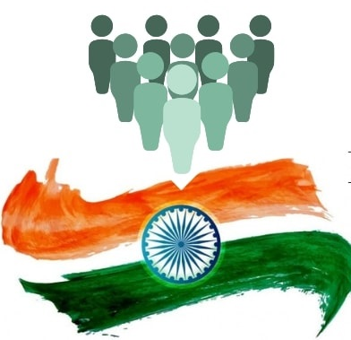
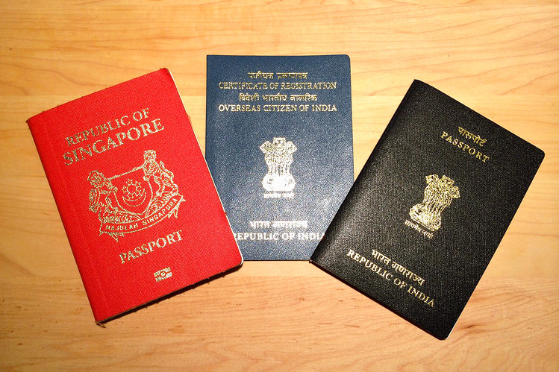

Slide 4
Citizenship in India I
Citizenship is the status of a person recognized under law as being a legal member of a sovereign state or belonging to a nation.
In India, Part II of the Constitution of India (Articles 5-11) deals with the Citizenship of India.
The term citizenship entails the enjoyment of full membership in any State in which a citizen has civil and political rights.

Slide 5
ARTICLE 5 : CITIZENSHIP AT THE COMMENCEMENT OF THE CONSTITUTION
At the commencement of this Constitution, every person who has his domicile in the territory of India and –
(a) who was born in the territory of India; or
(b) either of whose parents was born in the territory of India; or
(c) who has been ordinarily resident in the territory of India for not less than five years immediately preceding such commencement, shall be a citizen of India.

Slide 6
ARTICLE 6: RIGHTS OF CITIZENSHIP OF CERTAIN PERSONS WHO HAVE MIGRATED TO INDIA FROM PAKISTAN
Notwithstanding anything in Article 5, a person who has migrated to the territory of India from the territory now included in Pakistan shall be deemed to be a citizen of India at the commencement of this Constitution if –
(a) he or either of his parents or any of his grand-parents was born in India as defined in the Government of India Act, 1935 (as originally enacted); and
(b)(i) in the case where such person has so migrated before the nineteenth day of July 1948, he has been ordinarily resident in the territory of India since the date of his migration, or

Slide 7
ARTICLE 6: RIGHTS OF CITIZENSHIP OF CERTAIN PERSONS WHO HAVE MIGRATED TO INDIA FROM PAKISTAN
(ii) in the case where such a person has so migrated on or after the nineteenth day of July 1948, he has been registered as a citizen of India by an officer appointed on that behalf by the Government of the Dominion of India on an application made by him therefor to such officer before the commencement of this Constitution in the form and manner prescribed by that Government:
Provided that no person shall be so registered unless he has been resident in the territory of India for at least six months immediately preceding the date of his application.

Slide 8
ARTICLE 7: RIGHTS OF CITIZENSHIP OF CERTAIN MIGRANTS TO PAKISTAN
Notwithstanding anything in articles 5 and 6, a person who has after the first day of March 1947, migrated from the territory of India to the territory now included in Pakistan shall not be deemed to be a citizen of India:
Provided that nothing in this article shall apply to a person who, after having so migrated to the territory now included in Pakistan,
has returned to the territory of India under a permit for resettlement or permanent return issued by or under the authority of any law
and every such person shall for the purposes of clause (b) of Article 6 be deemed to have migrated to the territory of India after the nineteenth day of July 1948.

Slide 9
ARTICLE 8: RIGHTS OF CITIZENSHIP OF CERTAIN PERSONS OF INDIAN ORIGIN RESIDING OUTSIDE INDIA
Notwithstanding anything in Article 5, any person who or either of whose parents or any of whose grandparents was born in India as defined in the Government of India Act, 1935 (as originally enacted),
and who is ordinarily residing in any country outside India as so defined shall be deemed to be a citizen of India if he has been registered as a citizen of India by the diplomatic or consular representative of India
in the country where he is for the time being residing on an application made by him therefor to such diplomatic or consular representative,
whether before or after the commencement of this Constitution, in the form and manner prescribed by the Government of the Dominion of India or the Government of India.

Slide 10
ARTICLE 9: PERSONS VOLUNTARILY ACQUIRING CITIZENSHIP OF A FOREIGN STATE NOT TO BE CITIZENS
No person shall be a citizen of India by virtue of article 5 or be deemed to be a citizen of India by virtue of article 6 or article 8 if he has voluntarily acquired the citizenship of any foreign State.

Slide 11
ARTICLE 10: CONTINUANCE OF THE RIGHTS OF CITIZENSHIP
Every person who is or is deemed to be a citizen of India under any of the foregoing provisions of this Part shall, subject to the provisions of any law that may be made by Parliament, continue to be such citizen.

Slide 12
ARTICLE 11: PARLIAMENT TO REGULATE THE RIGHT OF CITIZENSHIP BY LAW
Nothing in the foregoing provisions of this Part shall derogate from the power of Parliament to make any provision with respect to the acquisition and termination of citizenship and all other matters relating to citizenship.

Slide 13
Citizenship Act, 1955
Citizenship of India can be acquired in the following ways:
Citizenship at the commencement of the Constitution
Citizenship by birth
Citizenship by descent
Citizenship by registration
Citizenship by naturalization
By incorporation of territory (by the Government of India)

Slide 14
Citizenship Act, 1955
People who were domiciled in India as on 26th November 1949 automatically became citizens of India by virtue of citizenship at the commencement of the Constitution.
Persons who were born in India on or after 26th January 1950 but before 1st July 1987 are Indian citizens.
A person born after 1st July 1987 is an Indian citizen if either of the parents was a citizen of India at the time of birth.
Persons born after 3rd December 2004 are Indian citizens if both parents are Indian citizens or if one parent is an Indian citizen and the other is not an illegal migrant at the time of birth.
Citizenship by birth is not applicable for children of foreign diplomatic personnel and those of enemy aliens.

Slide 15
Termination of Indian Citizenship Termination of citizenship is possible in three ways according to the Act:
Renunciation: If any citizen of India who is also a national of another country renounces his Indian citizenship through a declaration in the prescribed manner, he ceases to be an Indian citizen. When a male person ceases to be a citizen of India, every minor child of his also ceases to be a citizen of India. However, such a child may within one year after attaining full age become an Indian citizen by making a declaration of his intention to resume Indian citizen­ship.
Termination: Indian citizenship can be terminated if a citizen knowingly or voluntarily adopts the citizenship of any foreign country.
Deprivation: The government of India can deprive a person of his citizenship in some cases. But this is not applicable to all citizens. It is applicable only in the case of citizens who have acquired the citizenship by registration, naturalization, or only by Article 5 Clause (c) (which is citizenship at commencement for a domicile in India and who has ordinarily been a resident of India for not less than 5 years immediately preceding the commencement of the Constitution).

Slide 16
Persons of Indian Origin (PIO) Card
A person would be eligible for the PIO card if he:
Is a person of Indian origin and is a citizen of any country except Pakistan, Sri Lanka, Nepal, Bangladesh, Bhutan, China or Afghanistan, or
Has held an Indian passport at any other time or is the spouse of a citizen of India or a person of Indian origin.
PIO cardholders can enter India with the multiple entry feature for fifteen years. They do not need a separate visa.

Slide 17
Overseas Citizen of India (OCI) Card
OCI Card is for foreign nationals who were eligible for Indian citizenship on 26th January 1950 or was an Indian citizen on or after that date.
Citizens of Pakistan and Bangladesh are not eligible for OCI Card. An OCI cardholder does not have voting rights.
OCI is not dual citizenship. OCI cardholders are not Indian citizens.
The OCI Card is a multipurpose, multiple-entry lifelong visa for visiting India.
Persons with OCI Cards have equal rights as NRIs in terms of financial, educational, and economic matters. But they cannot acquire agricultural land in India.

Slide 18
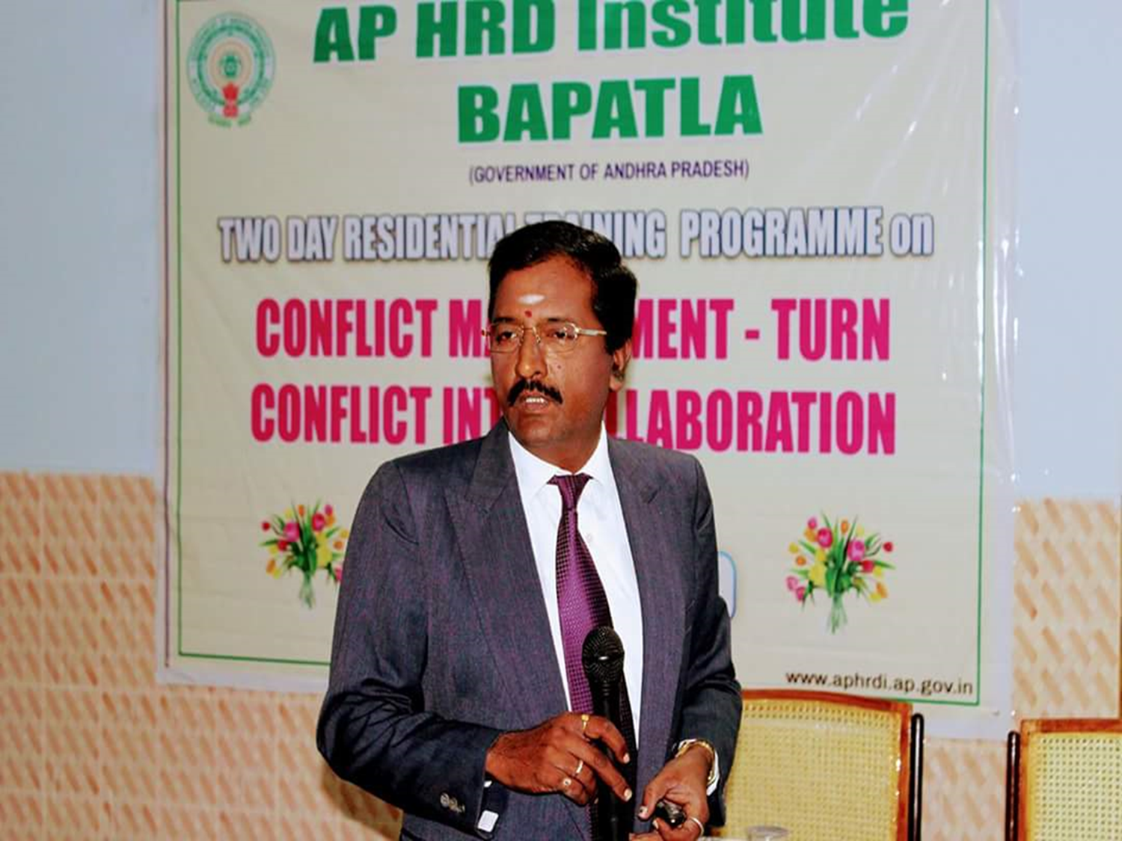
Professor & Lawyer
Puttu Guru Prasad

